Slide 1




Commissioning the Lowell Titan Monitor Telescope
Cameron Piotti, Gerard van Belle
NAU, Lowell Observatory

Slide 2
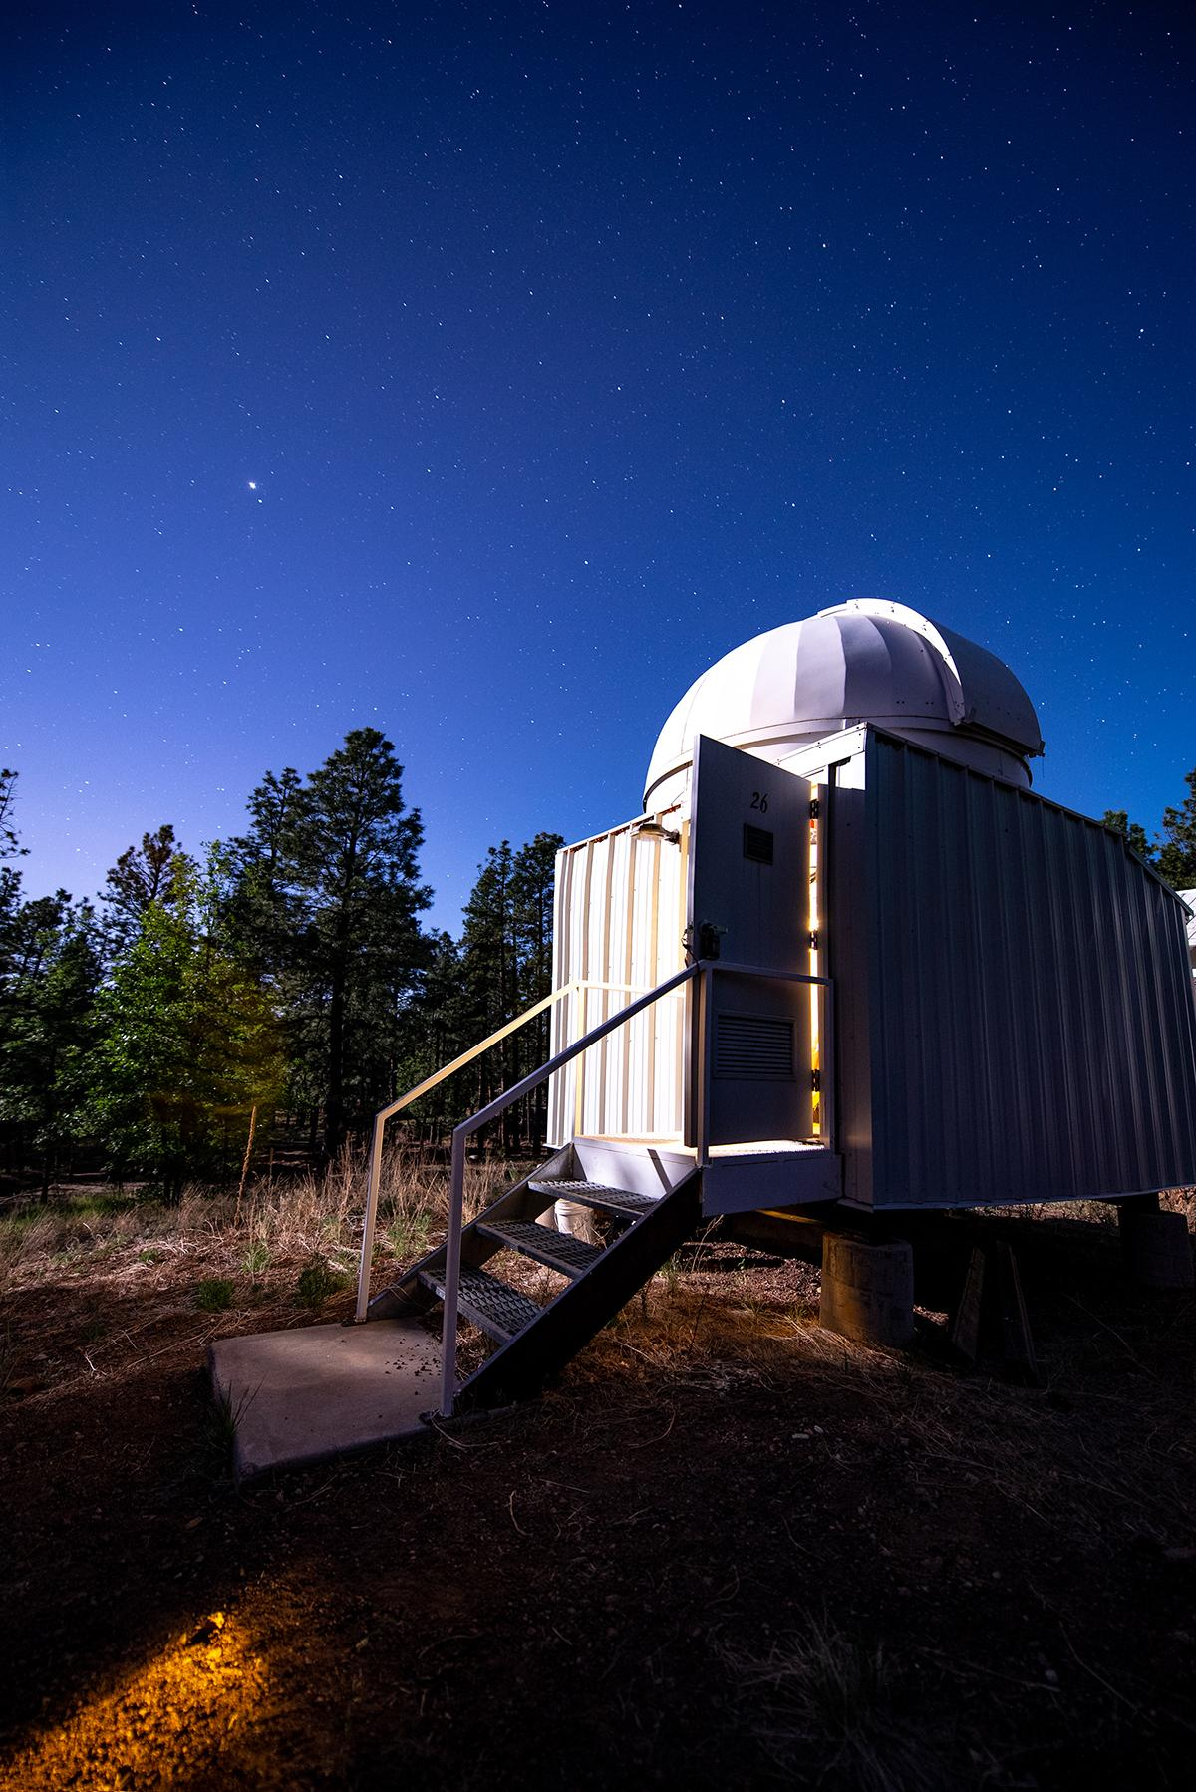
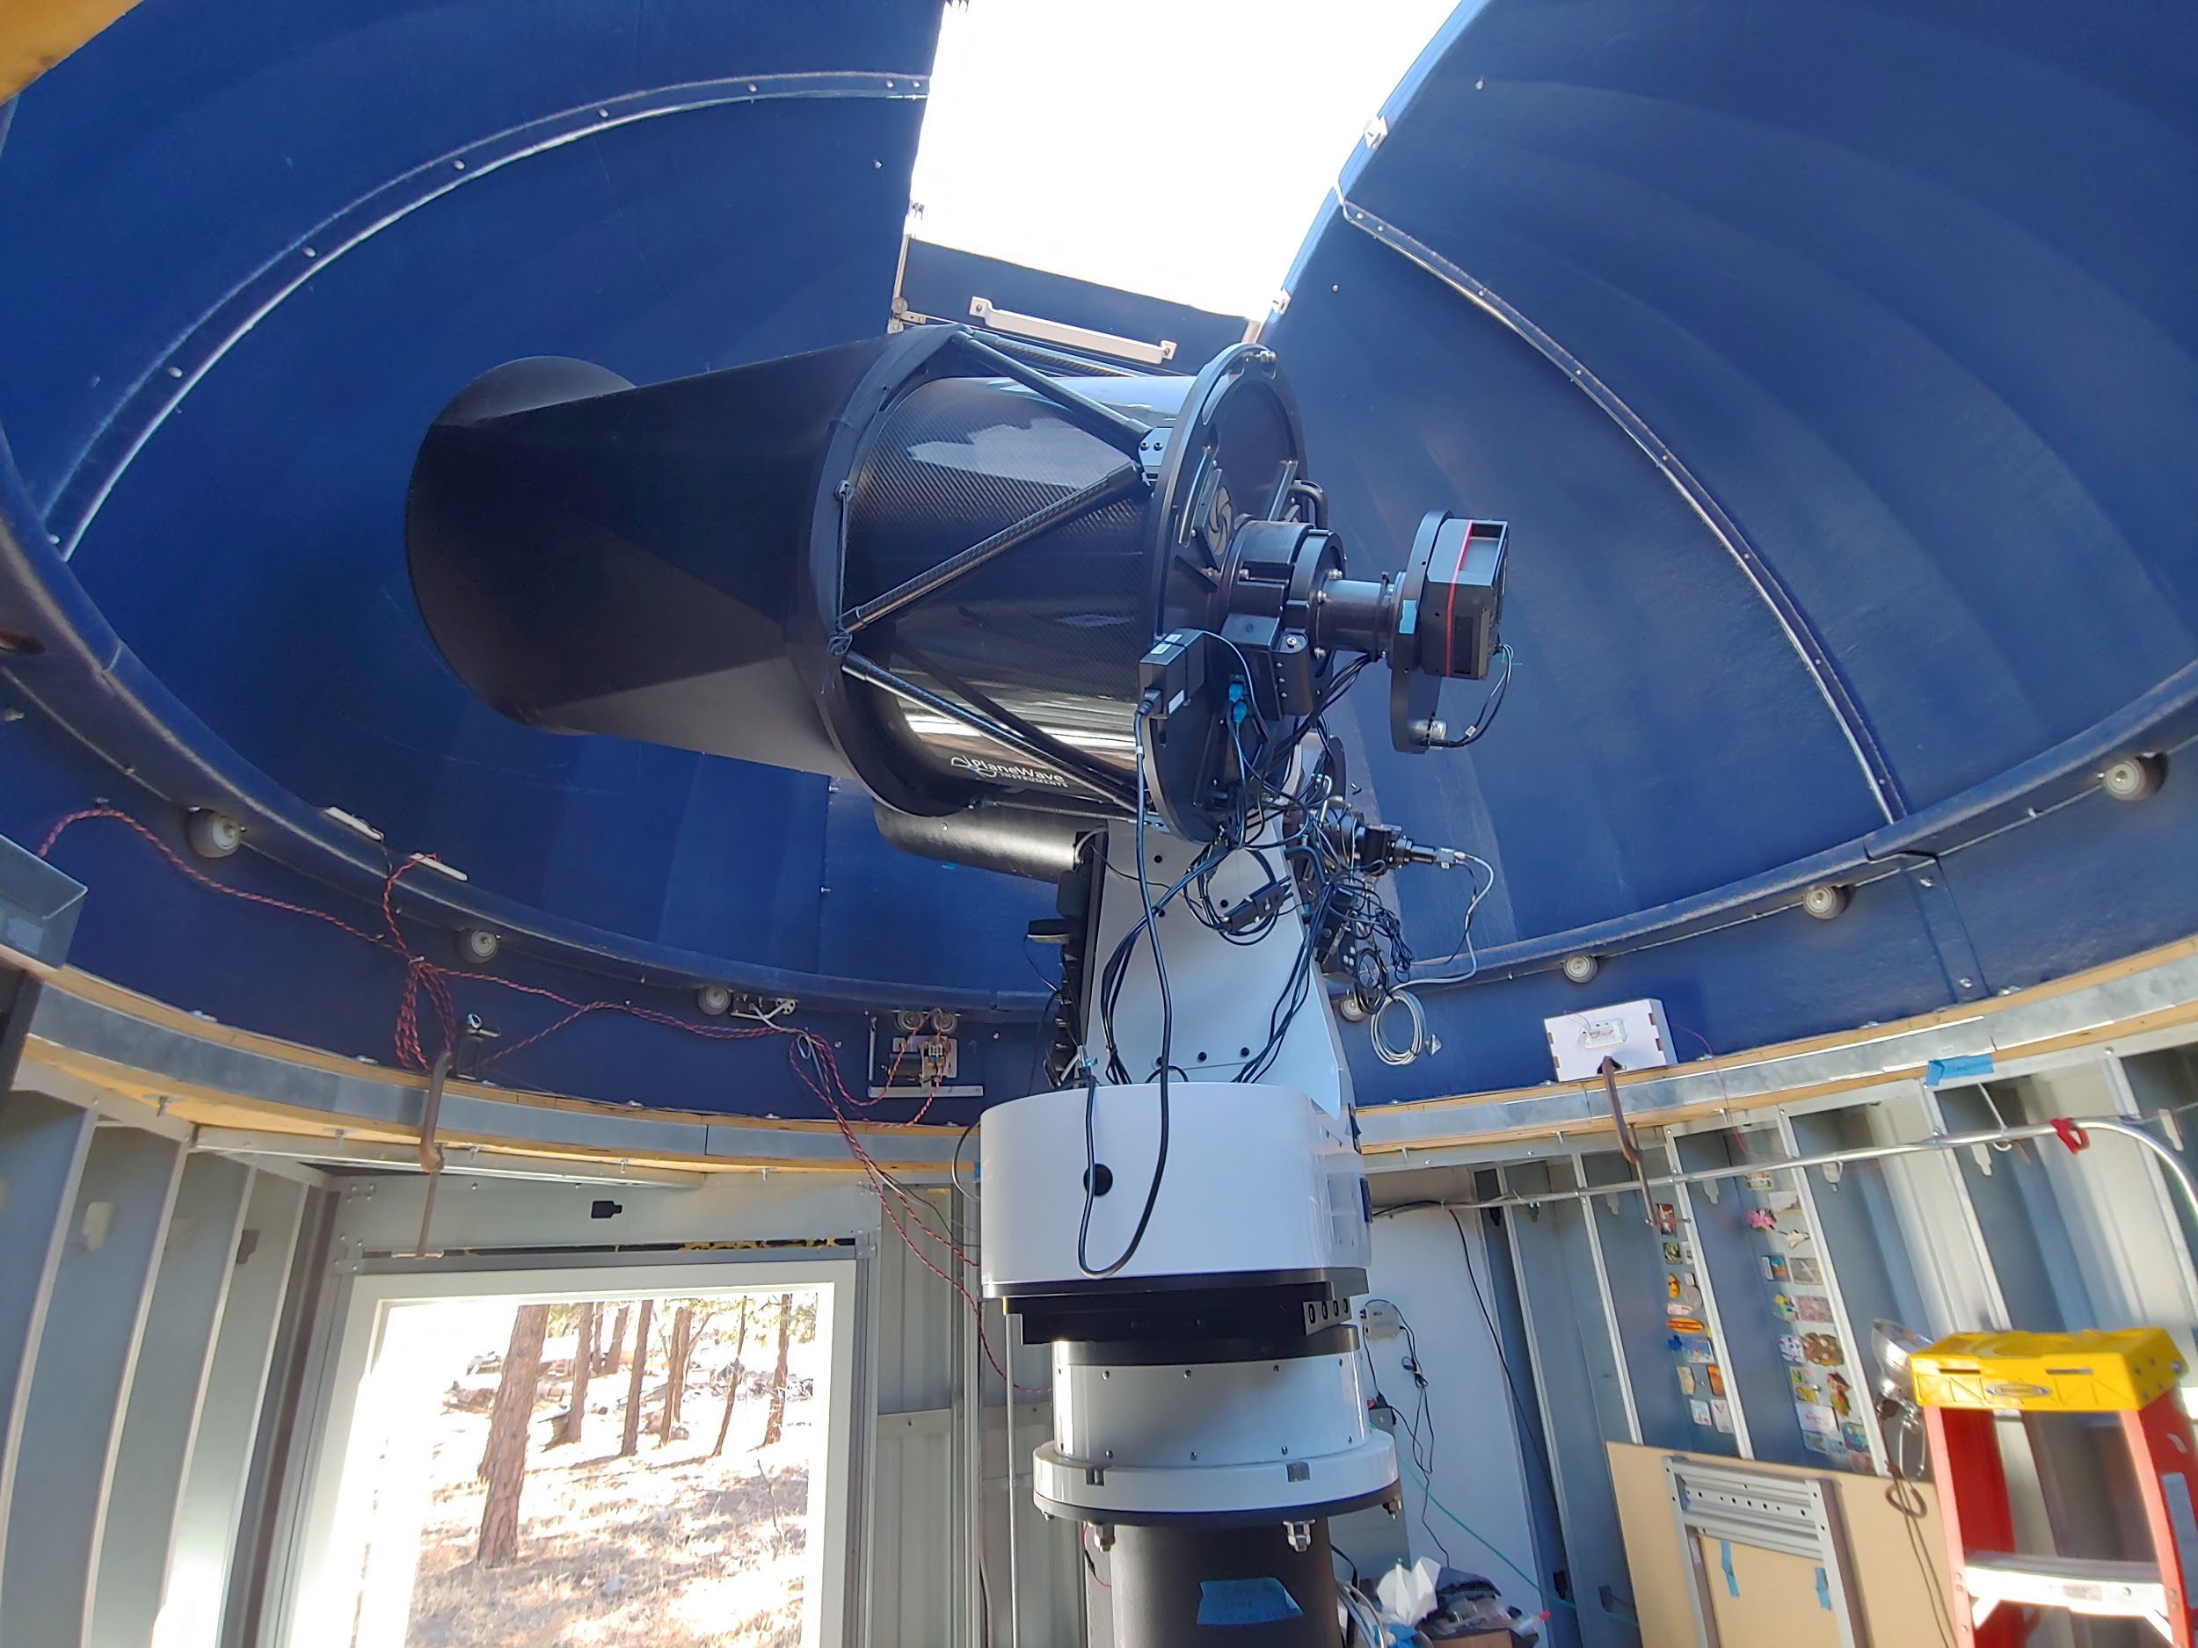
The Lowell Titan Monitor (TiMo)
At Lowell Observatory (Flagstaff) at Mars Hill campus
20” telescope
Fully robotic operations
Includes: telescope, camera, filter wheel, dome, weather station(s)

Slide 3
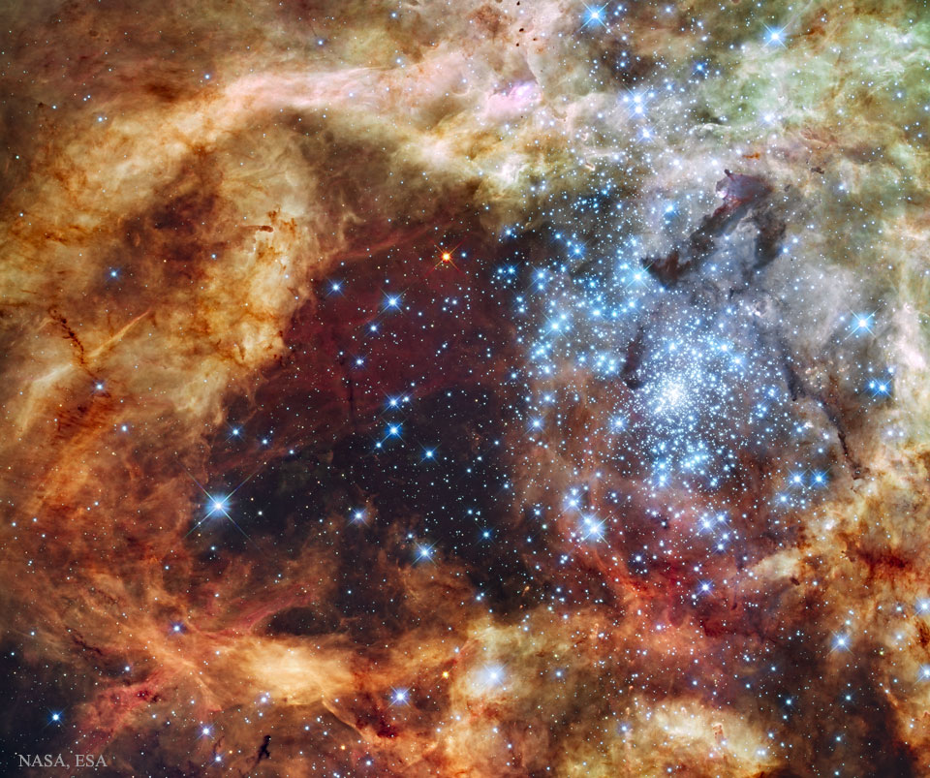
Science Case: Measurement of Absolute Flux of Stars
Enabled by careful calibration of measurements
Focus of this Space Grant Project
Corrections / considerations:
Filter curve
Detector curve
Atmospheric extinction
Star Cluster R136
F. Paresce,R. O'Connell
APOD

Slide 4
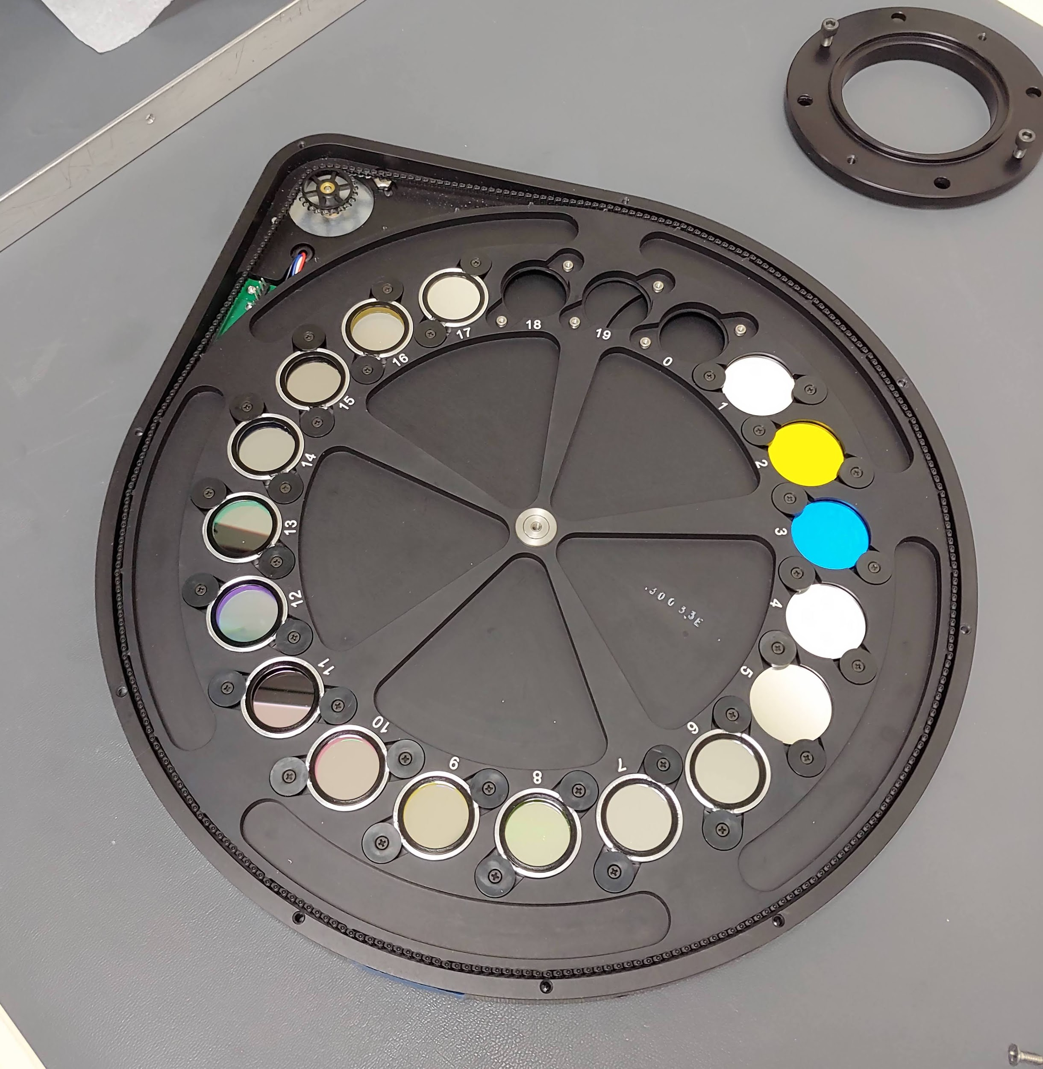
Filtered Observations
Timo 20-position filter wheel
17 different ‘colors’
Brightness measures from violet to far red
Each filter has a characteristic transmissivity
Central wavelength, width
Show filter curves figure (next slide)

Slide 5
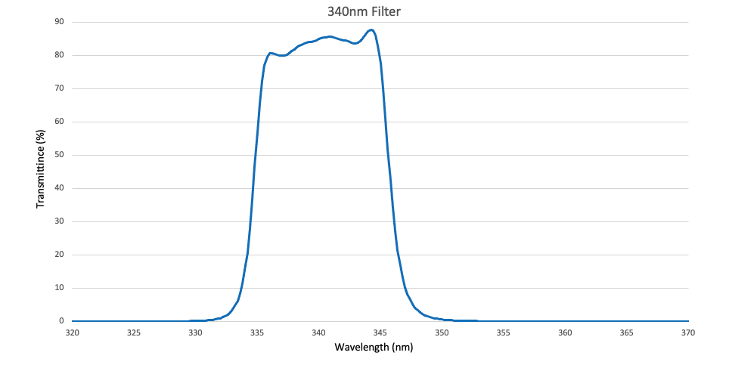
Filter Curves Example

Slide 6
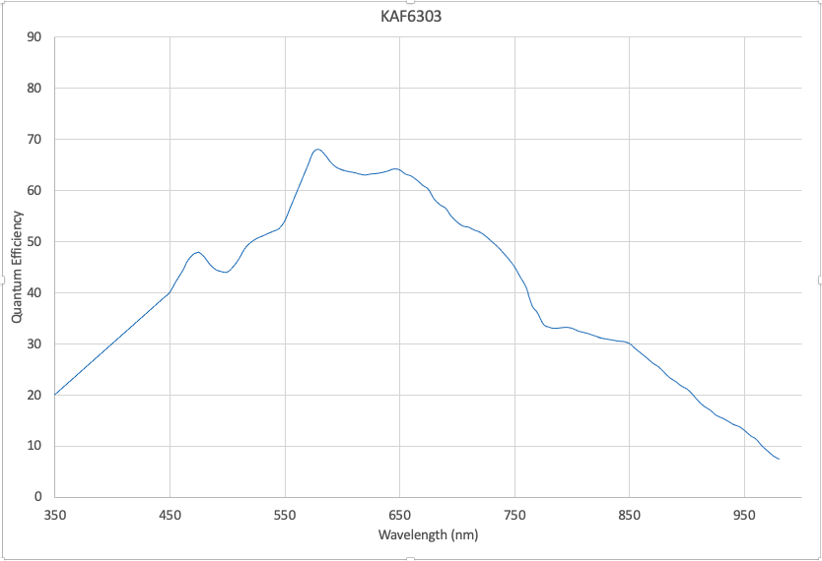
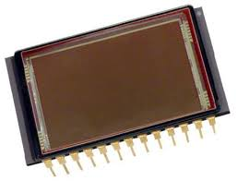
Detector QE
CCD: charge coupled device
Detector for TiMo, similar to detector in your phone
CCD quantum efficiency
Response versus wavelength

Slide 7
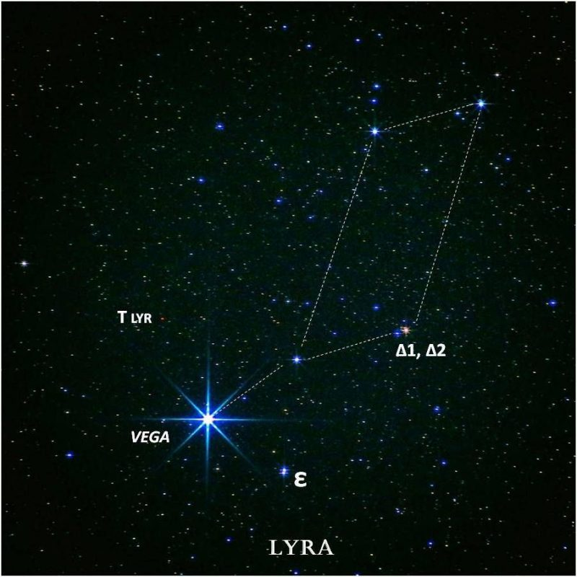
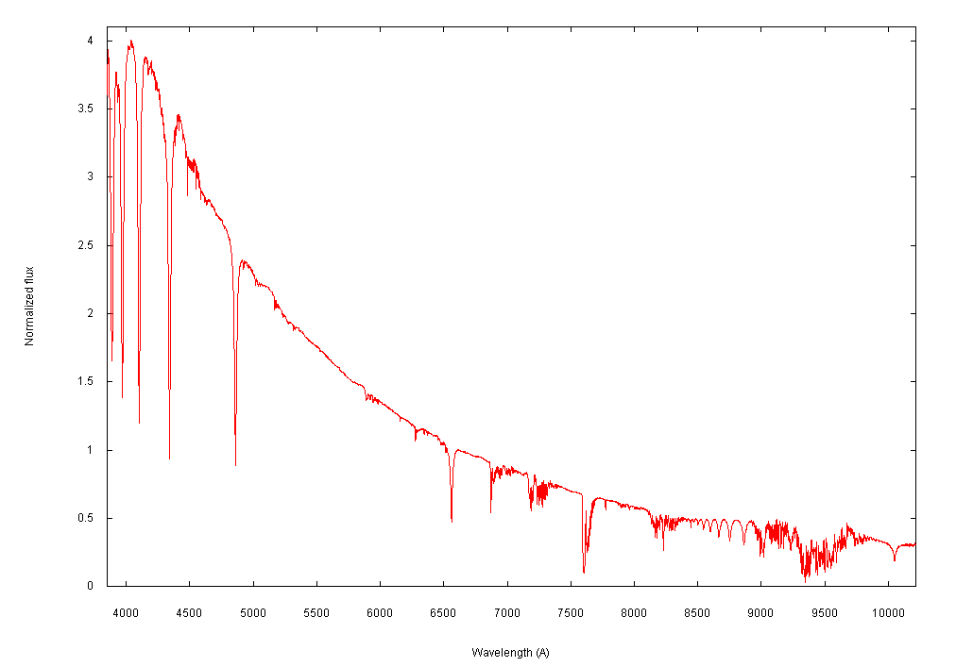
Comparison to Vega
That one
Flux standard in astronomy
Our ‘measurement ruler’
Zero point for each filter
How much light from Vega would be seen in each filter?

Slide 8
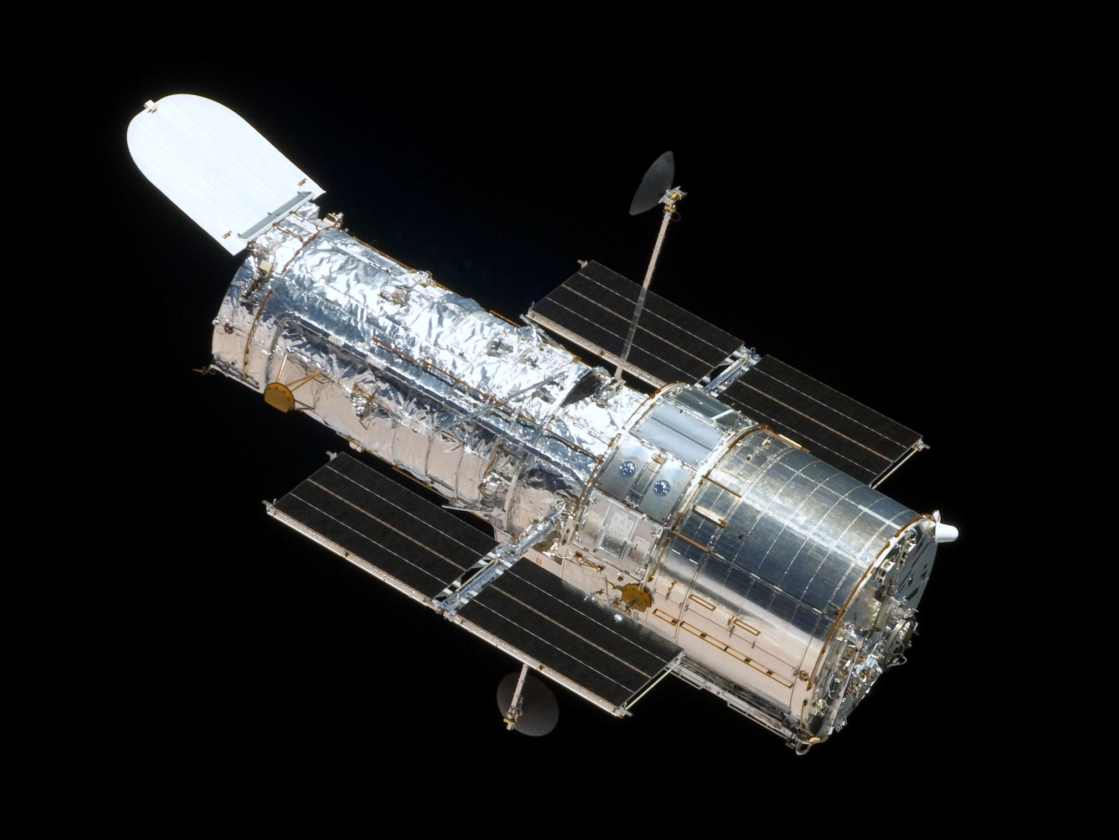
Extend to the Whole Sky: Secondary standards
Using Vega zero points, establish brightnesses of HST STIS NGSL stars
Hubble Space Telescope standards
STIS (Space Telescope Imaging Spectrograph)
NGSL (Next-Gen Spectral Library)
HST measures flux without contamination from
Earth’s atmosphere
Catalog of flux-calibrated stars
NASA

Slide 9
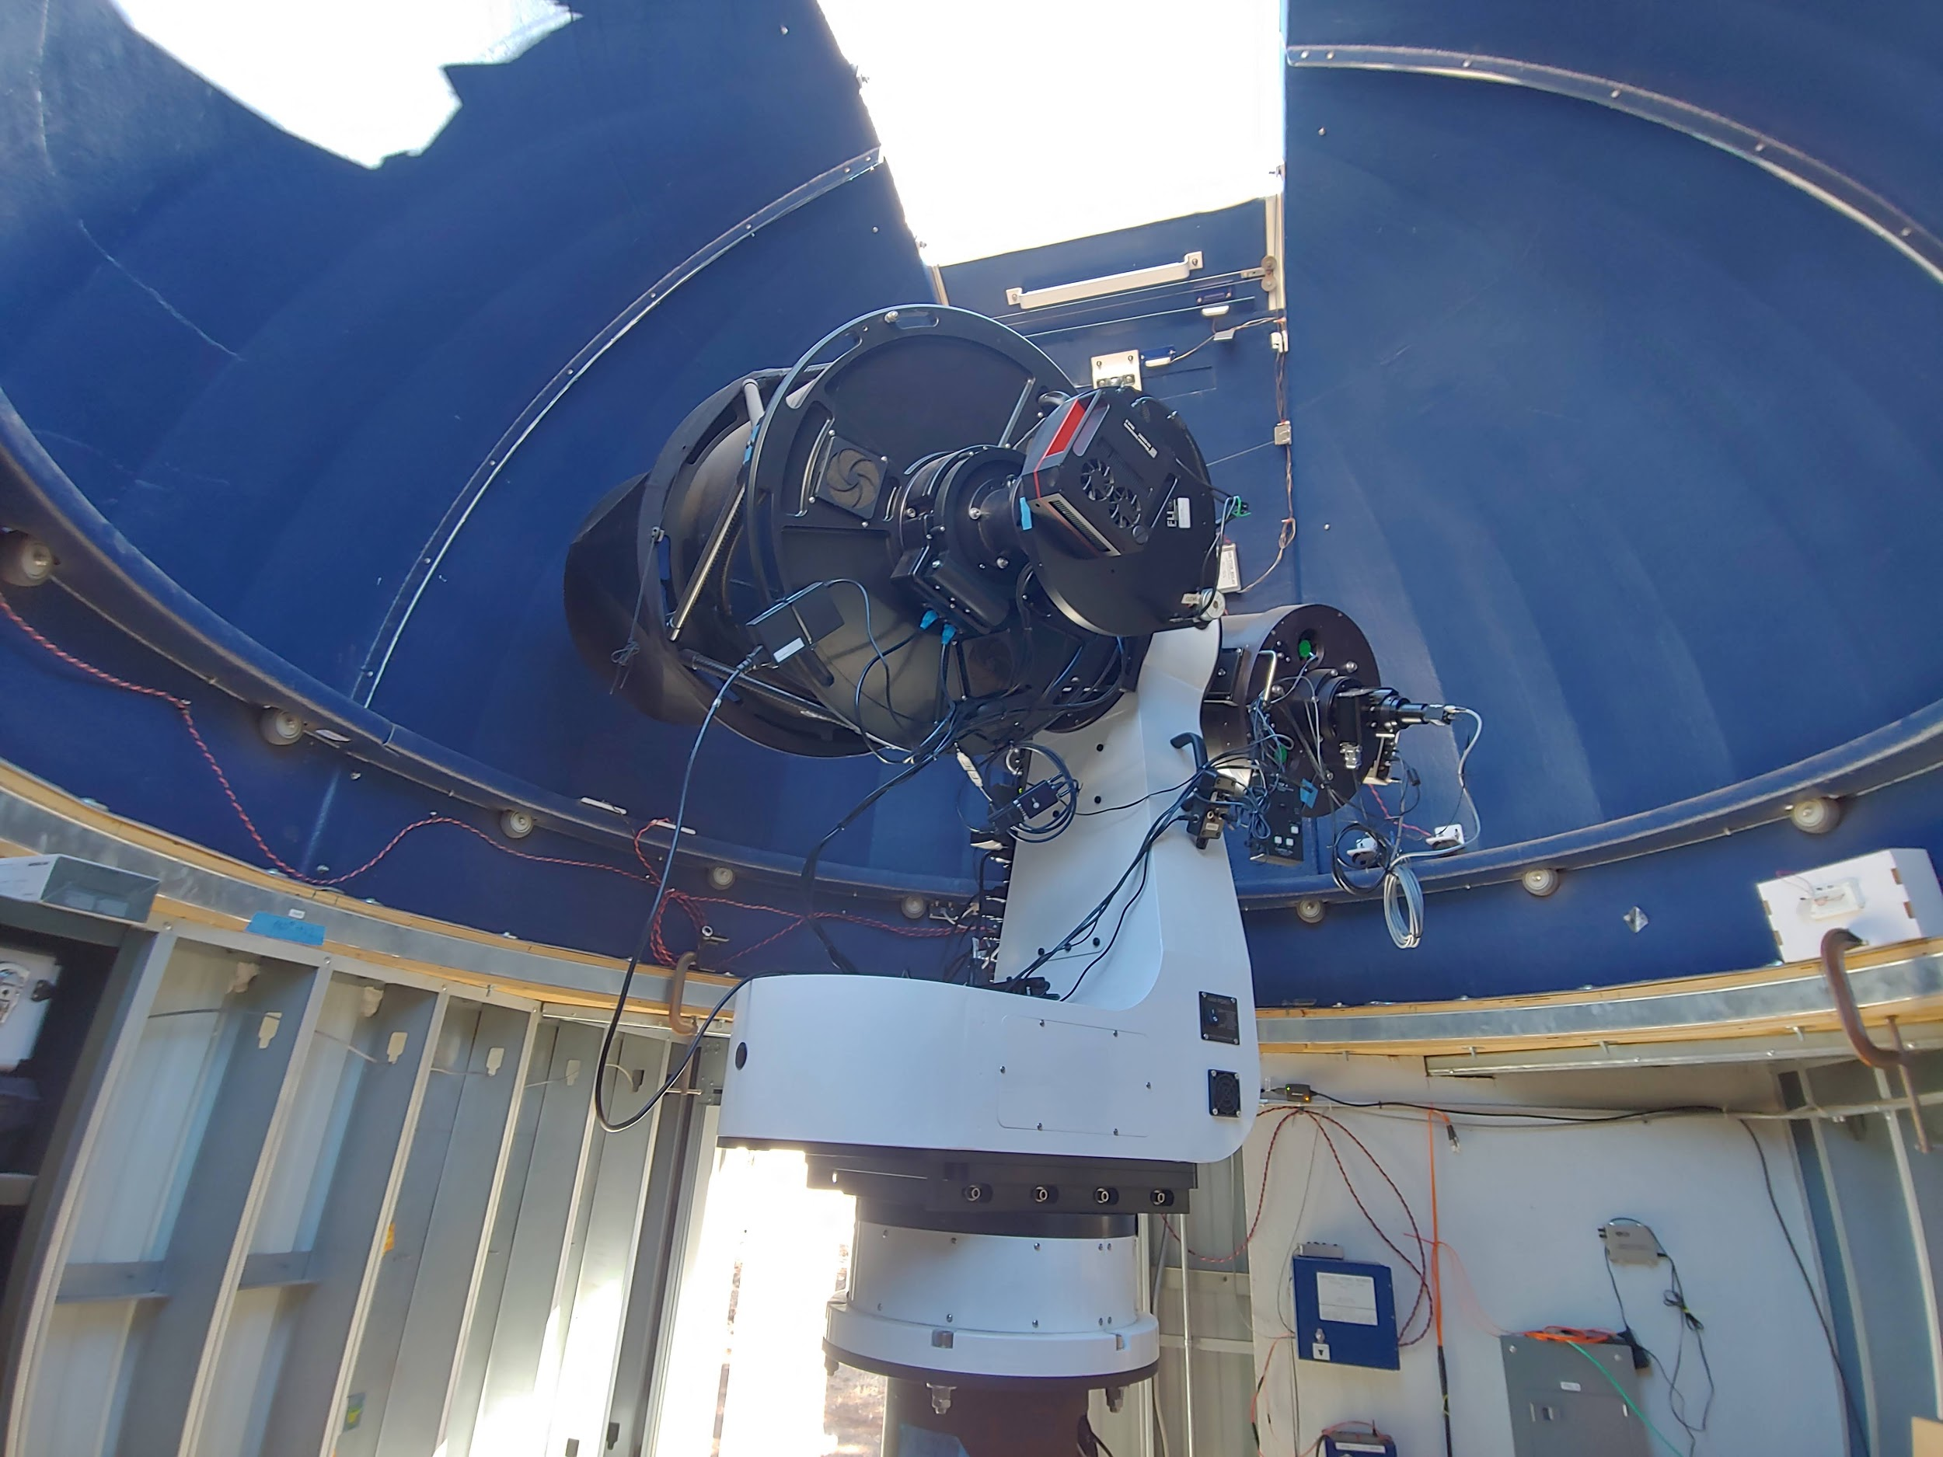
Using the Calibrated Standards for Science
Observations
Interleave of ‘known stars’ of HST STIS NGSL with science targets
Observe at different zenith angles
Allows for characterization of Earth’s atmospheric extinction

Slide 10
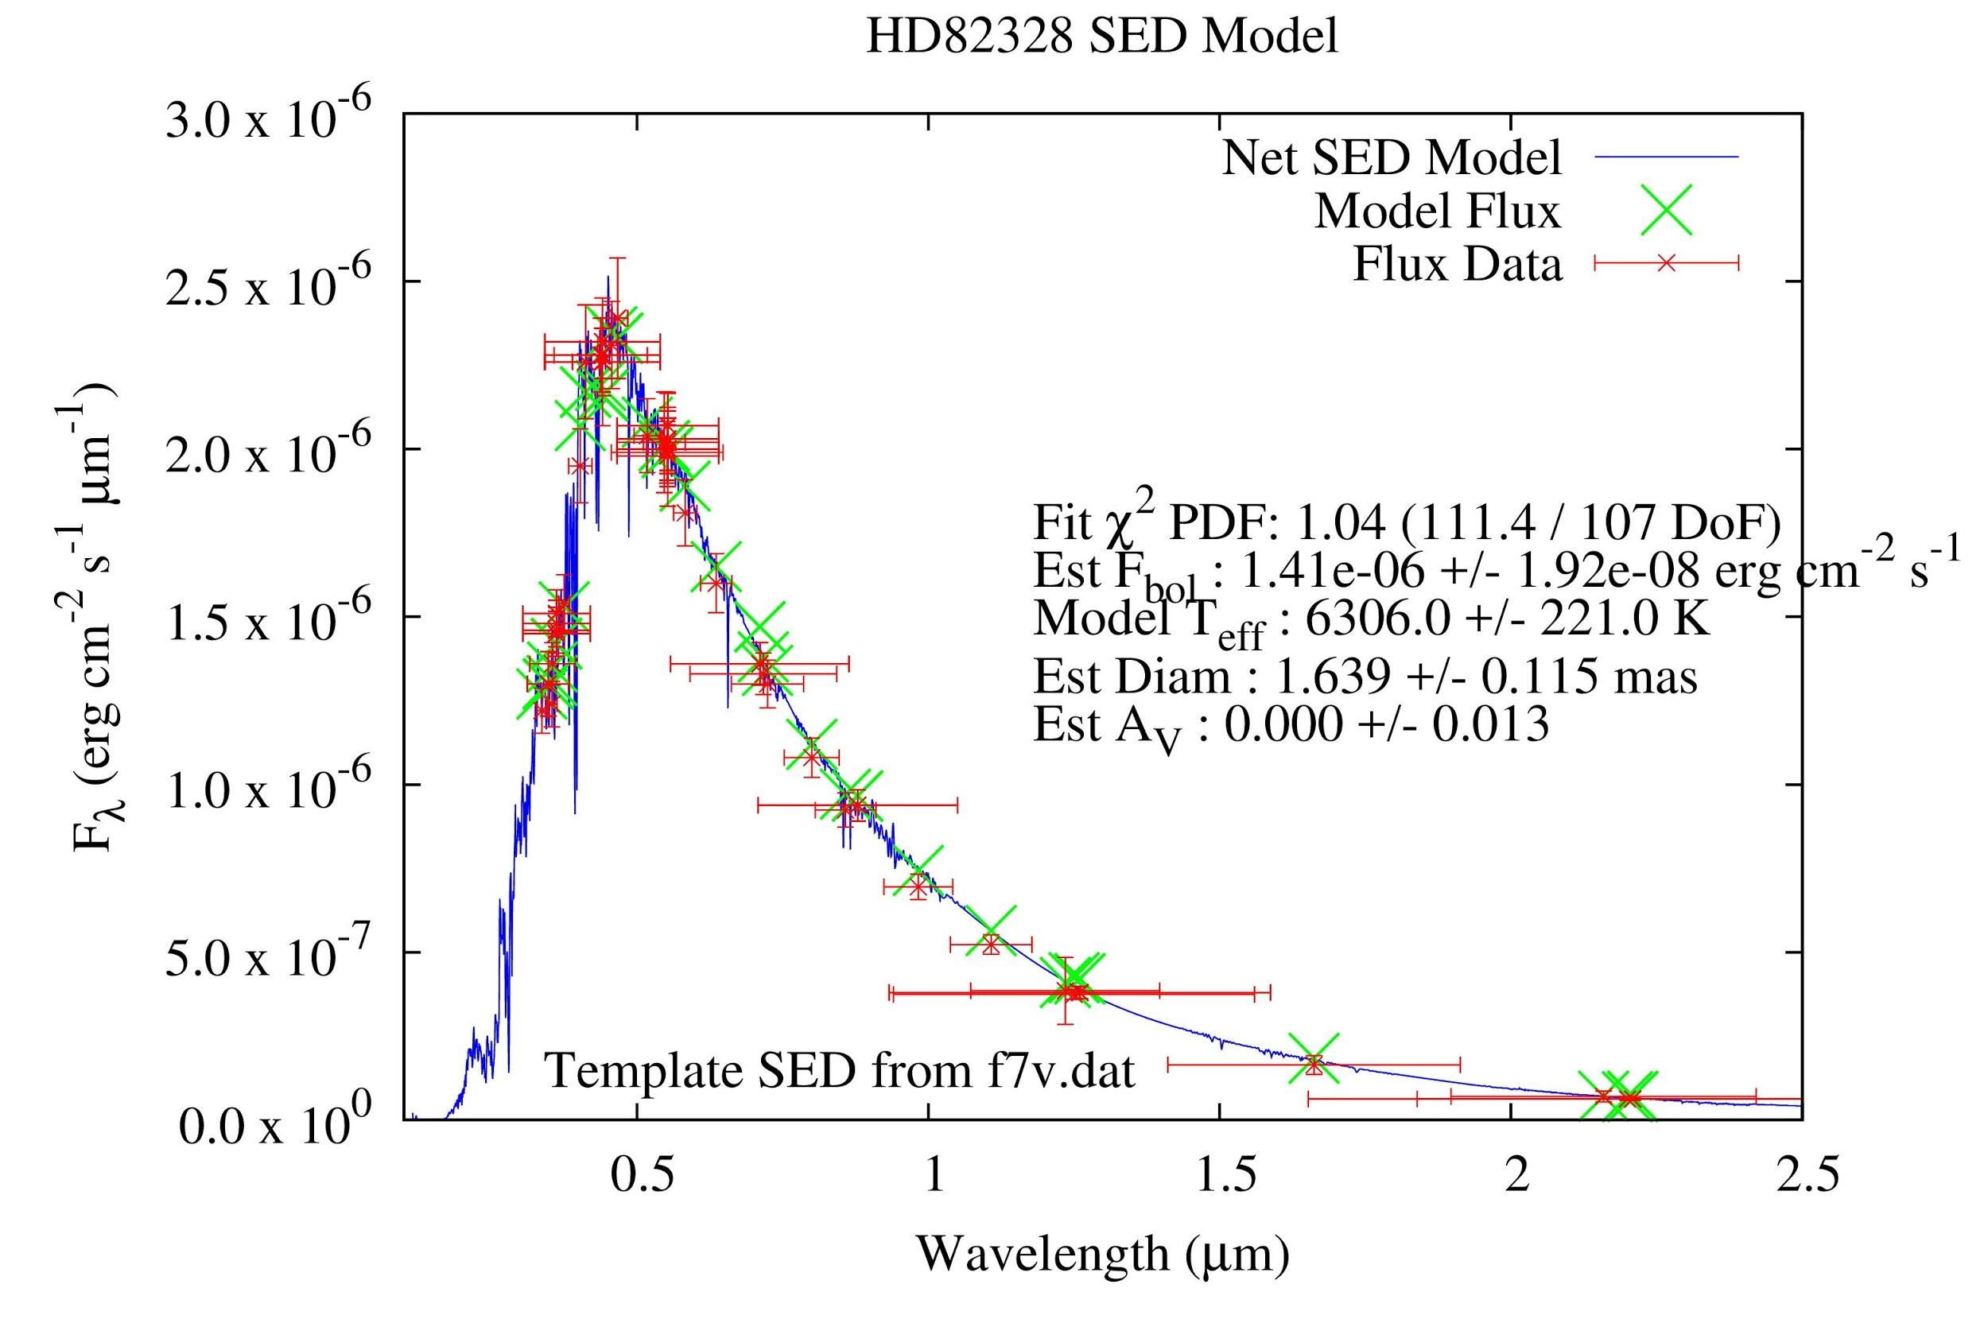
Enabled Astrophysics: Stellar Fundamental Parameters
Brightness measurements allow us to pin down the ‘spectral energy distribution of a star’
i.e. ‘area under the curve’
Our measures at many colors allow selection of correct spectral template (blue)
Useful for direct measures of stellar temperature

